Slide 1
A Hybrid Movie Recommendation System with Context Awareness and Diversity Optimization
BY S Kartik Iyer M25CSA025 Ravi sharma m25csa024 Satyam pal m25csa026

Slide 2
Introduction
Weighted Hybrid movie recommendation system for large-scale data
Combines:
Content-Based Filtering
Collaborative Filtering (ALS)
Incorporates context awareness:
Mood
Time-of-day
Includes diversity-aware re-ranking → avoids repetitive recommendations
Built using Apache Spark for:
Distributed processing
Scalable model training

Slide 3
Related work
Recommendation systems have been extensively studied for personalized content delivery
Content-Based Filtering
Recommends items based on feature similarity (e.g., genres, metadata)
Collaborative Filtering
Uses user–item interaction data
Commonly applies matrix factorization techniques
Hybrid Approaches
Combine both methods to overcome key challenges:
Cold-start problem
Data sparsity
Limited diversity
Recent Models (EASE-R, RP3Beta)
Improve scalability and efficiency
Still struggle with balancing accuracy, diversity, and computational cost

Slide 4
Proposed model
Hybrid Recommendation Framework
Combines Content-Based and Collaborative Filtering (ALS)
Weighted scoring mechanism to balance both approaches
Content-Based Module
Uses movie features (genres, metadata)
Recommends similar items based on user preferences
Collaborative Filtering Module
Learns user–item interaction patterns
Uses ALS (Matrix Factorization) for scalable recommendations

Slide 5
Context-Aware Layer
Incorporates mood and time-of-day
Adapts recommendations to user situation
Diversity Optimization
Re-ranking mechanism to reduce repetitive genres
Ensures varied and engaging recommendations
Personalization & Real-Time Updates
Uses user history and interactions
Continuously refines recommendations
Scalable Architecture
Implemented using pyspark
Supports large-scale data processing

Slide 6
Designed to handle large-scale datasets (millions of user ratings & movies)
PySpark Integration
Enables distributed data processing
Handles data across multiple nodes for faster computation
Scalable Collaborative Filtering
Uses ALS (Alternating Least Squares) from Spark MLlib
Efficiently trains on large datasets

Slide 7
Distributed Data Processing
Data partitioning and parallel computation
Faster aggregation and feature generation
System Optimization
Memory + disk persistence
Adaptive query execution
Efficient resource utilization
Outcome
Reduced computation time
Improved scalability and system stability

Slide 8
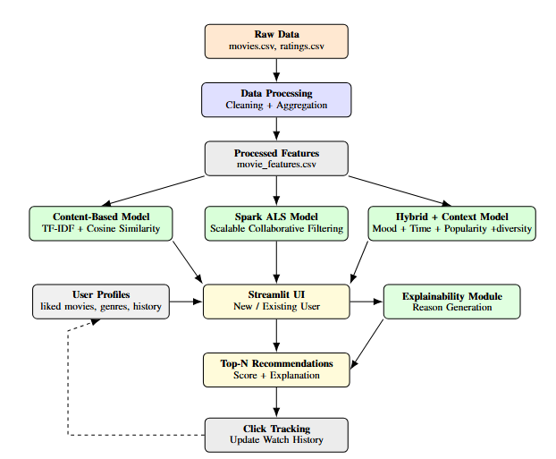

Slide 9
User interface and profile management
Interactive Web Interface (Streamlit)
Simple and user-friendly design
Enables seamless interaction with the system
User Types Supported
New Users: Select preferred genres & liked movies
Existing Users: Get recommendations based on history
Key Features
Movie selection via dropdown
Genre and mood-based filtering
Real-time recommendation display
Previously watched section

Slide 10
User Profile Management
Stores:
User ID
Liked movies
Preferred genres
Watch history
Personalization
Combines explicit preferences (genres, likes)
And implicit behavior (clicks, watch history)
Real-Time Updates
Profiles updated dynamically with user interactions
Continuously improves recommendation accuracy
Cold-Start Handling
Uses stored preferences for returning users
Provides recommendations even without history

Slide 11
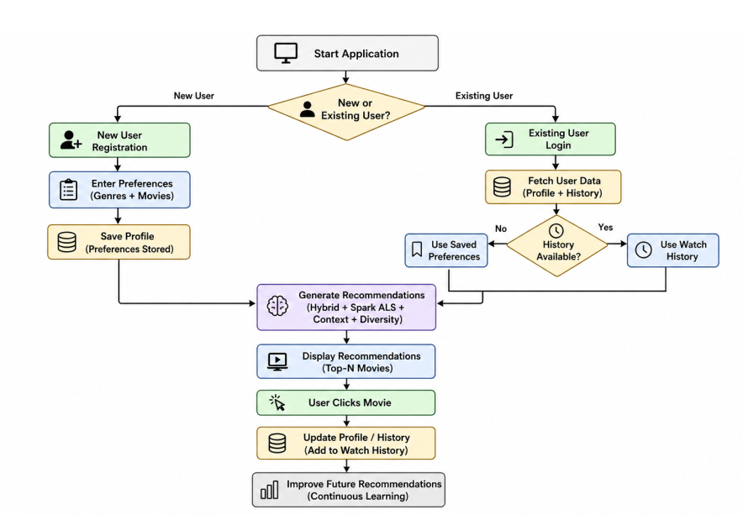

Slide 12
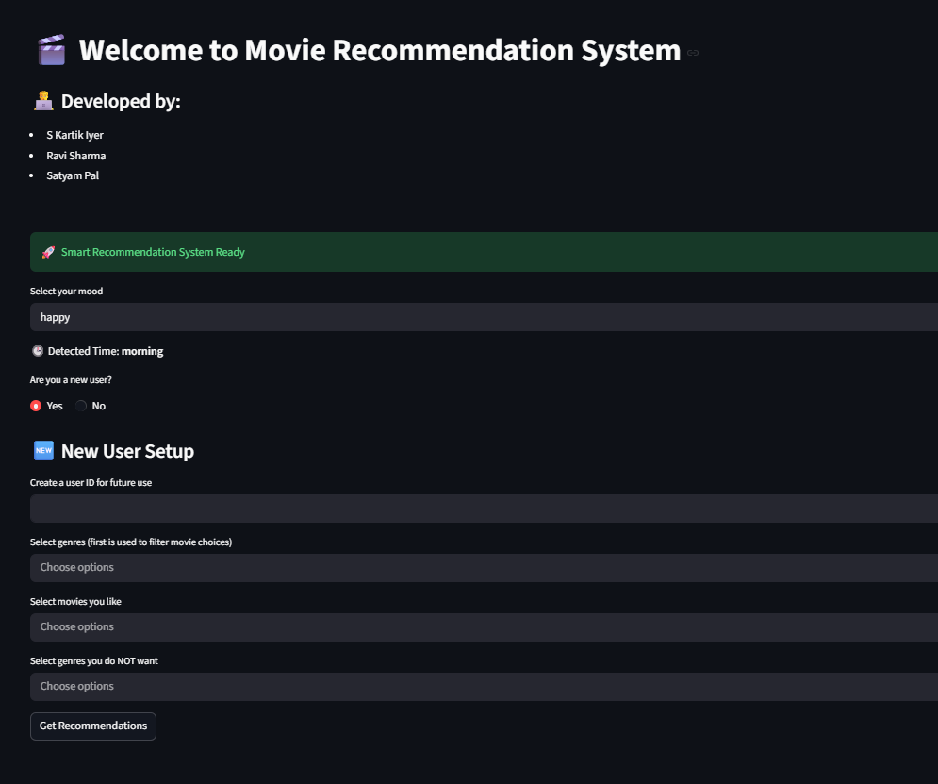

Slide 13
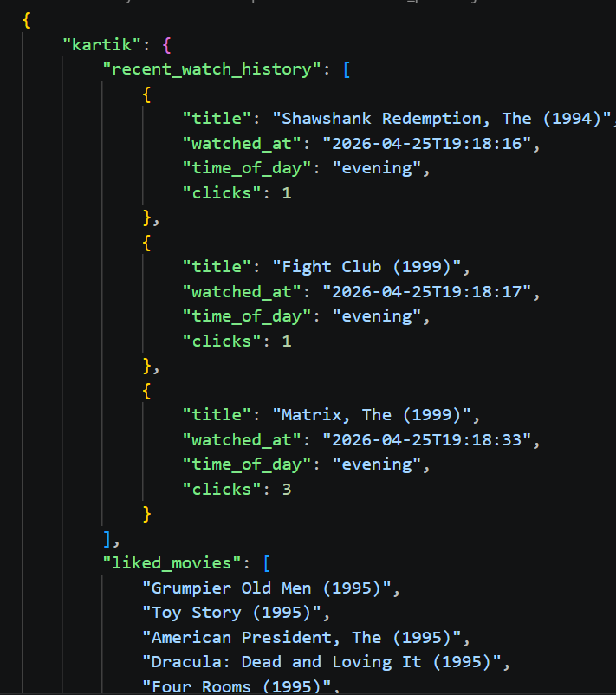
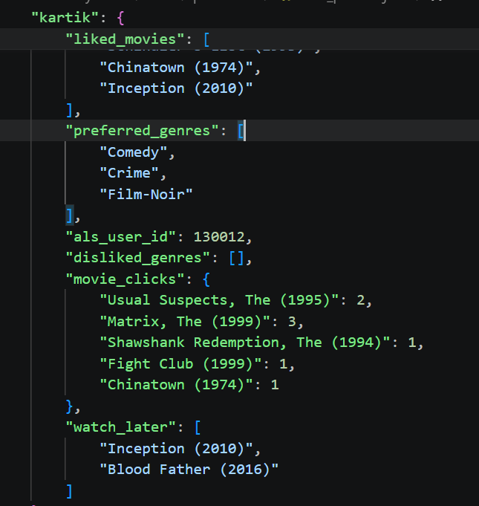

Slide 14
Evaluation
Evaluation Metrics
Precision@10 → Relevance of top-10 recommended movies
Recall@10 → Ability to retrieve relevant items
NDCG@10 → Ranking quality of recommendations
Genre Coverage → Measures diversity of recommendations

Slide 15
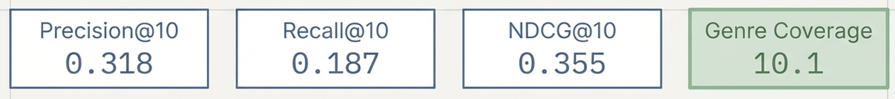
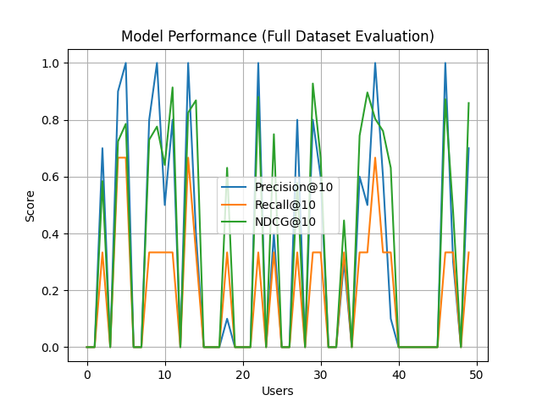
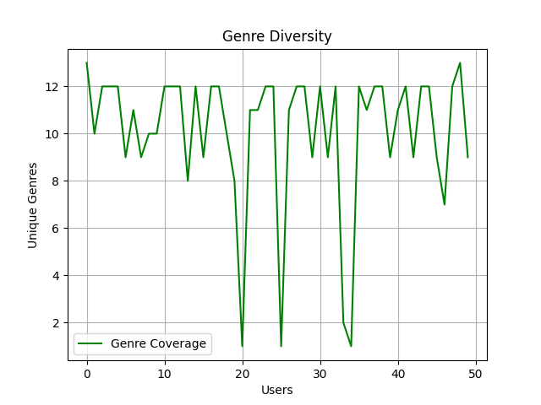

Slide 16
System Enhancements
Improved Recommendation Quality
Stronger focus on liked genres, liked movies, and watch history
Balanced scoring using:
Top-3 liked movie similarity (focus)
Full liked-list average (coverage)
Enhanced Cold-Start Handling
Uses multiple liked movies/genres instead of 1–2 inputs
Prevents single-movie dominance

Slide 17
Diversity & Personalization
Introduced negative genre list (exclude unwanted genres)
Increased recommendations to Top-15
Added highly-rated movies (“You may also like”)
Better Explainability
Each recommendation tagged with:
Genre-based reasoning
Liked-movie similarity
Dynamic explanation mix (not fixed patterns)
ALS-Based Collaborative Filtering
Improved scalability and recommendation strength

Slide 18
UI & User Experience Improvements
Cleaner Interface
Merged genre selection options (simpler UI)
Added search bar for selecting liked movies
User Controls & Interaction
Watch Again option for history
Watch Later playlist feature
Liked movies rewatch support
Enhanced User Profile Tracking
Stores:
Watch time → enables time-based recommendations
Click count → identifies favorite movies
Personalized Section
Favorite movies (most clicked)
Watch later playlist
Improved previous watch history display

Slide 19
User personalized scoring
NEW USER:
.50 genre+
0.30 similarity with liked movies + ###(.70 top 3 movies +0.30 overall)
0.15 popularity +
0.5 mood

Slide 20
EXISTING USER :
0.45 recent history +
0.35 genre match +
0.15 popularity +
0.5 mood

Slide 21
UI APPLICATION :
0.65 default +
0.35 ALS
diversity penalty : adjusted score = score - λ*(genre frequency)
Final Score + 0.2 bonus (introducing the temporal + mood component)

Slide 22


